Slide 1
Ethics in native literatures
(Adapted from Niigaanwewidam Sinclair’s essay, “Responsible and Ethical Criticisms of Indigenous Literatures” and Daniel Heath Justice’s essay, “Why Indigenous Literatures Matter”)

Slide 2
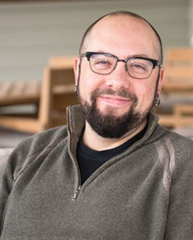
Daniel Heath Justice (Cherokee Nation):
Perspective
Beauty
Empowerment
Empathy
Legacy
Continuity
Possibility

Slide 3
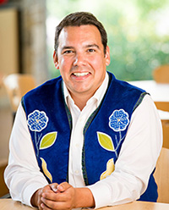
Niigaanwewidam Sinclair (Anishinaabe)
How do we forge a “responsible curiosity”?
Recognize the full humanity in Indigenous communities and writers
Situate narratives in their homes (time, place, context)
Every part of storytelling is political
Engaging with Indigenous literatures legitimates a long-standing and wide-ranging Indigenous intellectualism:
  ”Tribal literatures are… the oldest literatures in the Americas, the most American of American literatures. We ARE the canon.” (Craig Womack)
“Everything is medicine” (Wab Kinew)
Be brave (especially when there is opportunity for mistakes).
Admit what we don’t know.
Invite everyone to the literary feast – try each other’s food (even if you might not like it!)

Slide 4
The Marrow Thieves - Themes
Indigenous cultural wealth
Humans' relationship to nature
Trauma and Indigeneity
Family
Loss
The power of language
The climate crisis
Adulthood
Dreams

